Slide 1
MODEL VIEW CONTROLLER
Submitted by,
Aleesha Kurian

Slide 2
Contents
Introduction
MVC
History
Why MVC?
Working
MVC vs Web form
Advantages and disadvantages
Implementation
Conclusion

Slide 3
Introduction
Model–view–controller (MVC) is a software architecture pattern which separates the representation of information from the user's interaction with it .

Slide 4
The Model
The model is responsible for managing the data of the application.
It responds to the request from the view and it also responds to instructions from the controller to update itself
It is the lowest level of the pattern which is responsible for maintaining data.

Slide 5
The View
The View displays the data (the database records).
A view requests information from the model, that it needs to generate an output representation.
MVC is often seen in web applications, where the view is the HTML page.

Slide 6
The Controller
The Controller is the part of the application that handles user interaction.
Typically controllers read data from a view, control user input, and send input data to the model.
It handles the input, typically user actions and may invoke changes on the model and view

Slide 7
History of MVC
Trygve Reenskaug introduced MVC into “smalltalk-76”
Jim Althoff and others implemented MVC into “smalltalk-80”
Expressed as a general concept in 1988

Slide 8
Why MVC?
MVC (Model – View – Controller) is one of those concepts that only starts to make sense when you’re dealing with larger applications and/or when working on the same application with several developers.
MVC’s benefits are absolutely not restricted to large-scale, team-based development, but they become most obvious in such situations.

Slide 9
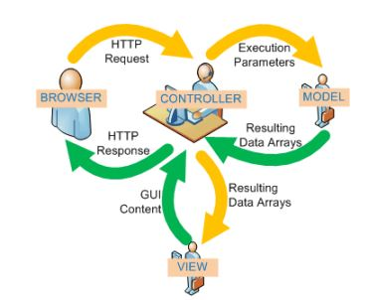
Working of MVC in web application

Slide 10
MVC vs Web Forms
MVC based applications | Web form based applications
It supports the Test Driven Programming model | It supports the Event Driven Programming model that preserves state over the HTTP
There is no event in MVC. | The Web Forms-based application provides many events and also is supported in many server controls.
MVC has no specific page life cycle. All individual components (such as Model, View and Controller) have their own life cycle. | There is a specific page life cycle in the web form page
Code behind is not tightly coupled with the View (User Interface). | Code behind is tightly coupled with the View (User Interface).

Slide 11
Advantages
Clear separation between presentation logic and business logic.
Each object in MVC have distinct responsibilities.
parallel development
Easy to maintain and future enhancements
MVC enforces separation that reduces complexity of project structure.
MVC support SEO and REST friendly URL.

Slide 12
Disadvantages
MVC sites require more time to develop over traditional applications
There is extensive use of jQuery / JavaScript / AJAX, it makes the form (application) complicated.
For parallel development there is a needed multiple programmers.

Slide 13
Where can use it?
It applies to all types of systems
And technologies(Java,Python,Ruby,Perl,SmallTalk,.Net,etc)

Slide 14
Implementation of MVC in Asp.net
Step 1: - Select the project template
Step 2: - Select the appropriate ASP.NET One options
Step 3: - Add Controller
Step 4: - Add Views
Step 5: - Connect the view to the controller
Step 6: - Run the program

Slide 15
Conclusion
The selection of technology varies from person to person.
MVC has a few advantages, such as more control over HTML; support of TDD, builtin support of SEO based URLs, and so on.
If you want these benefits then you can choose the MVC model.

Slide 16
THANK YOU

